Slide 1
Multi-Material 3D Printer
ECE480: Design Team 11
He Chen
Annalin Davis
Michael Saybolt
Josh Folks
Matt Luzenski

Slide 2
Outline
Introduction
Problem Statement
Background
Objectives
Designs
Design rankings
Proposed Solution

Slide 3
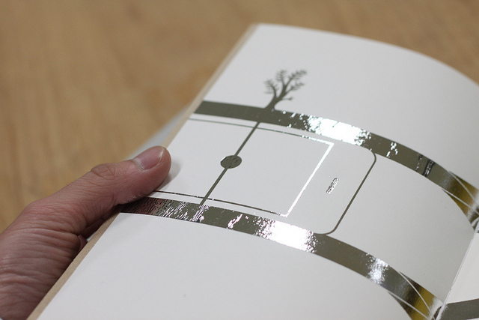
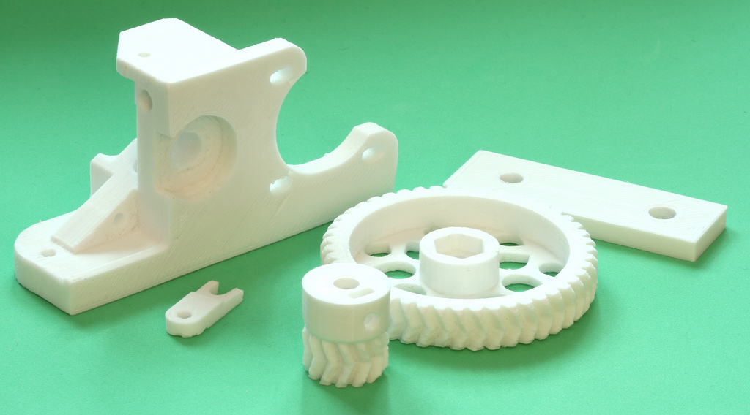
Introduction
3D printing
MSU technologies
Conductive parts

Slide 4
Problem Statement
3 axis gantry for dual printing of plastic and metal.
Proof of concept using multiple plastics

Slide 5
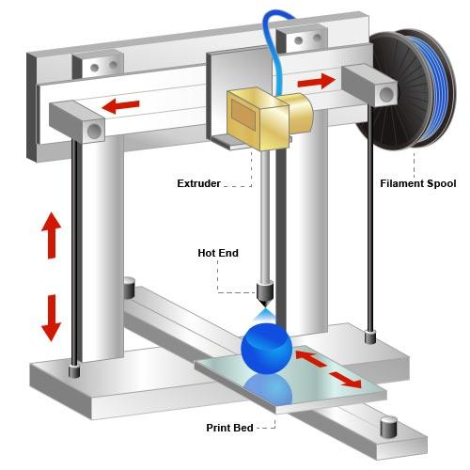
Parts of a 3D Printer

Slide 6
Background
Direct-Metal/Select Laser Sintering
Fused Deposition Modeling (FDM)
No metal FDM options
Plasma deposition
Multi-material capability

Slide 7
Objectives
Dual print head and dual material
Standardize printing head designs
Intuitive UI
Improve bonding properties of metal and plastic
Notes:
From the voice of customer we derived at four objectives we need to meet for this project.
First is dual print head and dual material. Since our sponsor will eventually want to print plastic and metal together in a single printer. Printing two different materials, in our case plastics is the best simulation we could use since the developmental head is not ready and 3D printing outside of plastics is extremely expensive. We can try to simulate some challenges we might encounter with metal by changing extrusion parameters of the plastic, such nozzle diameter, different feed rates and printing plastic on metal.
Second is standardizing a printing head design. Since the experimental print head has yet to conclude it’s final shape we would like to standardize the shape and mounting of all future heads on this printer. This will lead to very broad use of this printer that could print varies materials with different properties. Besides the physical properties, standardizing the software for different materials and heads is just as important.
This leads to the third objective, an intuitive user-interface. Since different materials will require different method of printing, it is important to develop a software that can adjust almost every parameters of printing. There will be numerous parameters and thus we need to create a powerful yet easy UI that our sponsor can and anyone can adapt to without much effort.
Lastly we need to investigate and possibly improve the bonding properties of metal and plastic together.

Slide 8
Design Goals (Hardware)
Accuracy
Adaptability
Dual-head printer
Compatible Software
Notes:
For our project, we need to choose a 3D printer and software(what is a program called that makes 3d printers print) that meet certain goals. The hardware of our project is the 3d printer itself. The 3d printer we choose should be accurate, capable of printing two materials at once, so it needs two printing heads. It should be adaptable and compatible with software that we can edit.
Our 3D printer needs to be fairly accurate because in future applications, it will be used to print a very thin layer of metal on top of a layer of plastic. The largest factor in a 3d printers accuracy is how the bed of the printer moves. If the bed of the printer moves in the x or y direction, it tends to become uncalibrated as the printed material weighs it down. Usually, the bed also moves in the z direction as well. A more accurate 3d printer will have a bed that only moves in the z-direction and the extruder head will move in the x and y direction.
We want a printer that is adaptable, that is, a printer that we can easily swap out the second plastic printing head. We want our end product to be something our sponsor can actually use to test their plasma deposition head. We will likely still have to create a new custom carriage to hold one plastic head and the plasma head, but having a 3d printer with an open design gives us more space to install these new features
To print two materials, we need to have two extruder heads. While it’s possible to attach another extruder head to a printer originally designed for only one, 3d printers exist that have two heads already mounted. The advantage of having a 3d printer with two heads already mounted is that it is already designed fit both heads. if we were to install another head on a printer that only had one originally, we would lose a lot of space and it would drastically increase the amount of coding we would have to do to solve this problem.
This brings us to software. Most 3d printers come with a microcontroller pre-installed to control the printer. An ideal printer would be compatible with multiple open source softwares. The more programs it is compatible with, the more choices we have for the next stage of the project. We will want full control of the printer heads. When the plasma deposition head is eventually mounted, the printer head will need to print the material in a different way than it would print two plastics.

Slide 9
Design Goals (Software)
Open source
Dual printing compatible
Ease of understanding
Ease of use
Notes:
We want to choose a program that best fits our needs for this project. We would like the program we choose to be open source, have some basis code for printing with two print heads, be easy for us to understand the code, and be easy for the user to use.
Open source software will give us more access to the code and should make the code easier to edit. Most software available for 3d printing is open source.
Having a program that can already handle two print heads will give us something to work with. It means we don’t have to start from scratch ….
The end product of the program needs to be intuitive and easy to use for the user, if the program we start with is already fairly easy to use there will be less for us to change. We can also build on the ideas that other programs provide for user accessibility.

Slide 10
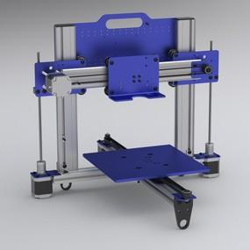
Designs
Ord Bot Hadron 3D Printer Mechanical Platform
Extruders
Microcontroller
Inaccuracy

Slide 11
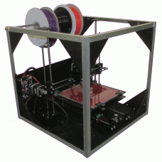
Designs
Asterid 1000HB 3D Printer
Dual Extruders
Software Options
Inaccuracy

Slide 12
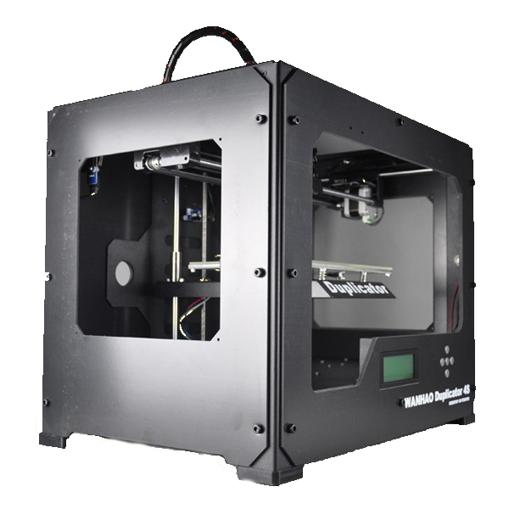
Designs
Wanhao 4S Duplicator 3D Printer
Dual Extruders
Accurate
Sturdy

Slide 13
Design Rankings
Engineering Criteria | Importance
 |  | ORD Bot Hadron 3D printer | Duplicator 4S | Asterid 1000HB 3D Printer
Accuracy | 5 | 3 | 9 | 3
Dual Extruder Heads | 3 | 1 | 9 | 9
Adaptability | 3 | 9 | 3 | 9
Compatibility with available software | 4 | 9 | 9 | 3
Price | 2 | 9 | 3 | 3
Totals |  | 99 | 123 | 87
Duplicator 4S
  High Accuracy
Asterid 1000HB
  Inexpensive
ORD Bot Hadron
  Open Chassis

Slide 14
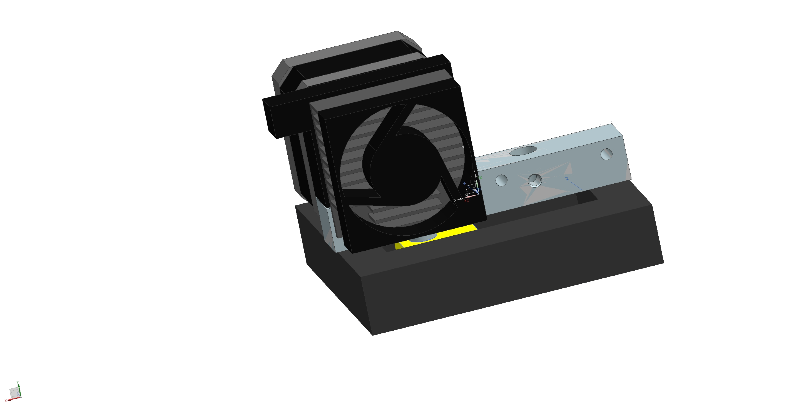
Proposed Design Solution
Duplicator 4S
Modify the Carriage
ReplicatorG

Slide 15
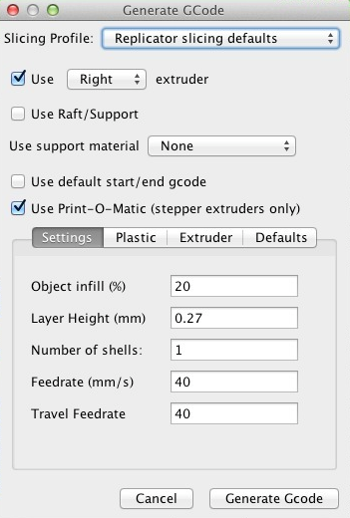
New Features
Material Selection
Extruder Temperature
Layer Height

Slide 16
Budget Breakdown

Slide 17
References
http://www.supermediastore.com/blog/article/nitty-gritty-3d-printing
http://www.automationtechnologiesinc.com/products-page/3d-printer/3d-printer-mechanical-platform-no-controller
http://www.plasticscribbler.com/store/Asterid-1000HB-3D-Printer
http://wanhaousa.com/products/duplicator-4s-steel-exoframe
http://replicat.org/usage
http://fashioningtech.com/profiles/blogs/switches-from-conductive-ink
http://www.3dspectra.com/3d-printing-services

Slide 18
Questions?
Thank you for your time!!

